Slide 1

LFG Made Easy

Slide 2

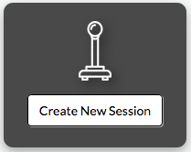
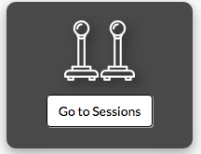
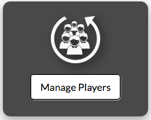
Create new session
Text 1
Revisit created sessions
Text 1
Manage players
Text 1

Slide 3

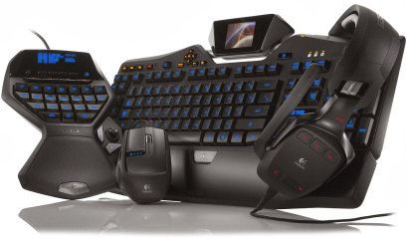
Sequelize
We used sequelize to do some things on the webpage
MySQL
we store some stuff in MySQL
Express
Item 1
Body-parser
Item 1

Slide 4

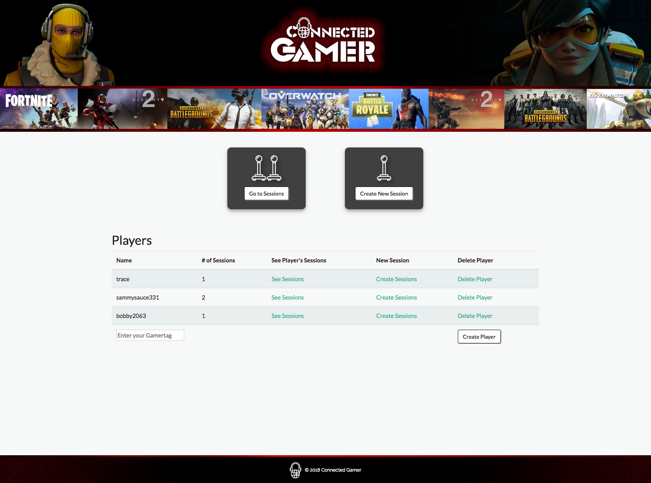
CREATE – A – PROFILE
Use your gamertag or Screen name
from your favorite platform to get started!
No Login in this version, will be implemented
in final version to streamline and personalize
your experience.

Slide 5
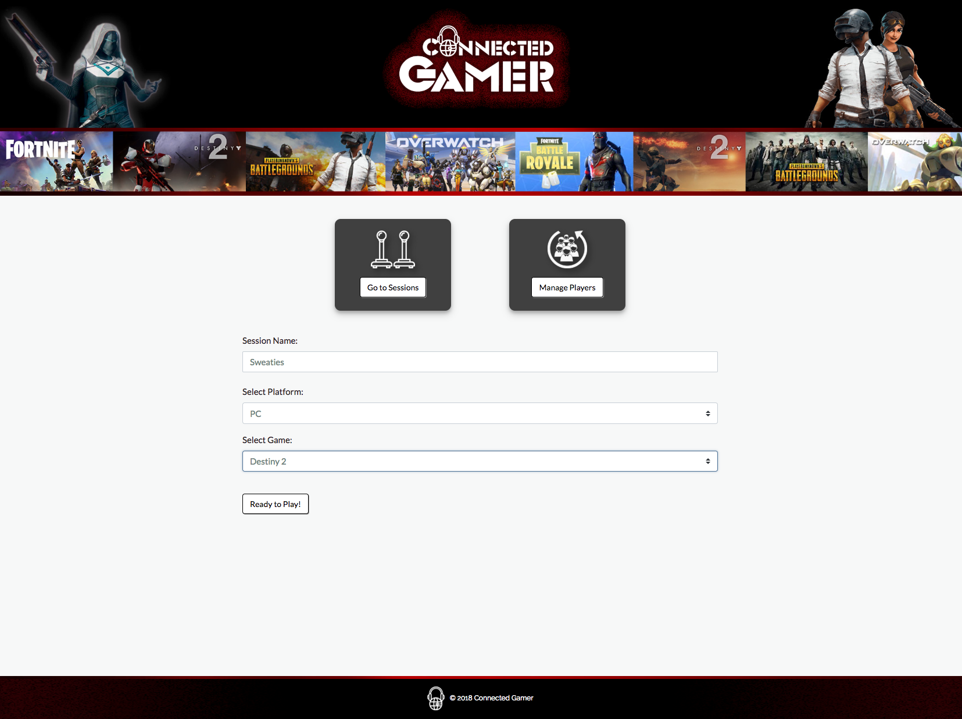
START A SESSION
Let everyone know what and how
you want to play!
Personalize your session name to set
the mood!
Let the interested gamers come to you!

Slide 6
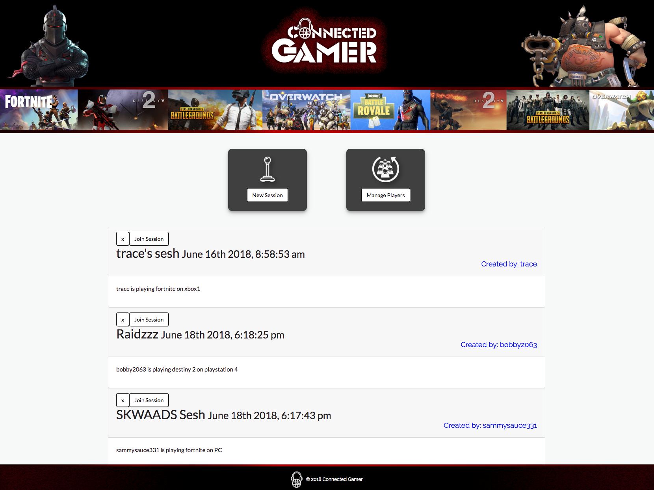
LET’S PLAY!
Choose the game that fits you!
Curated list of session options!
Remove listings you’re not interested in.
Join session to get details on how to
connect!

Slide 7

Login
Store

